Slide 1
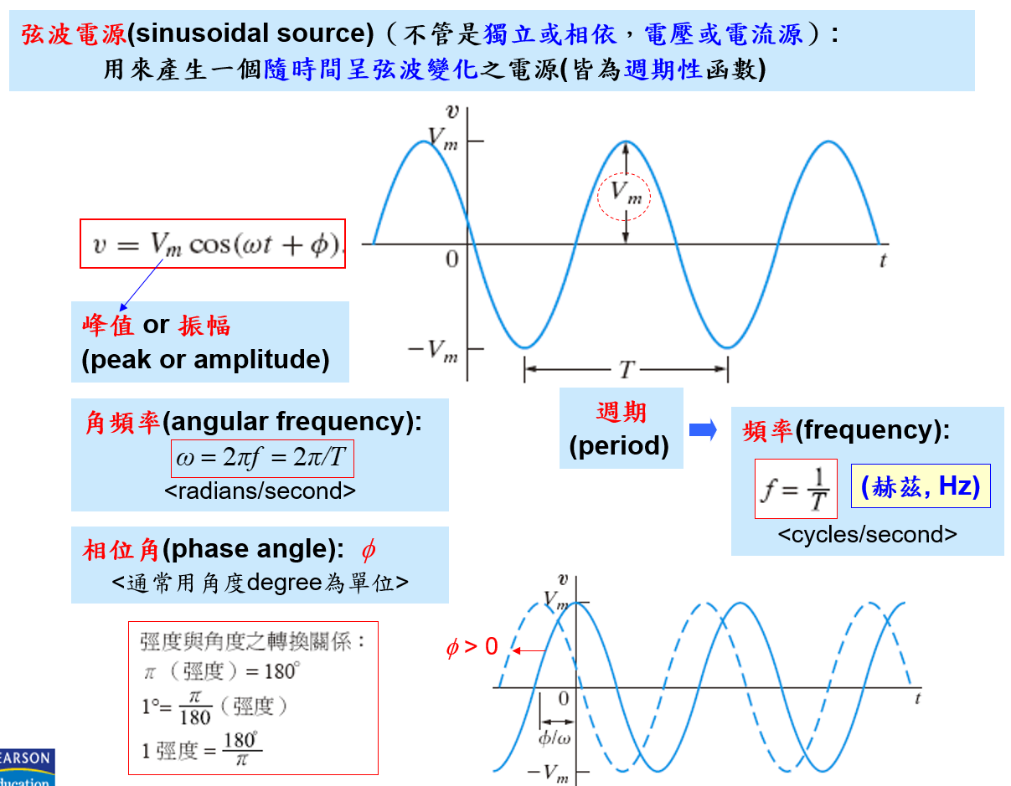

Slide 2
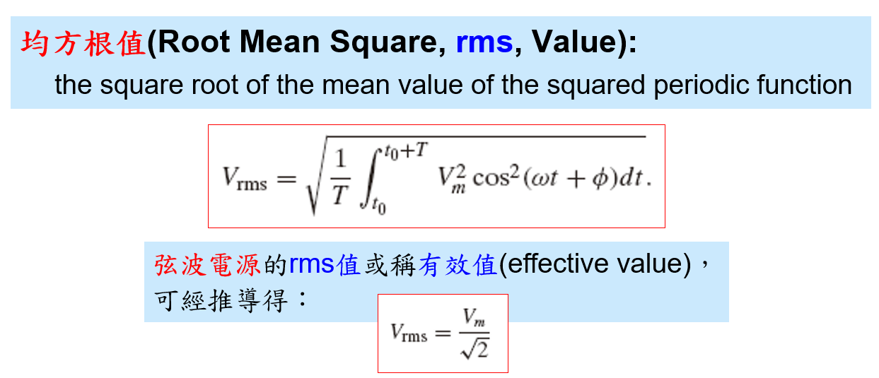
But How!!??

Slide 3
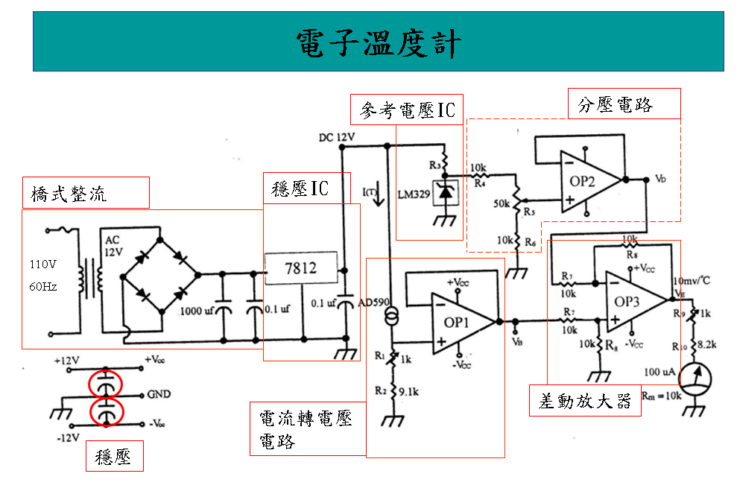
今日完成主題
(A)
(9)
(C)
(B)
(9)

Slide 4
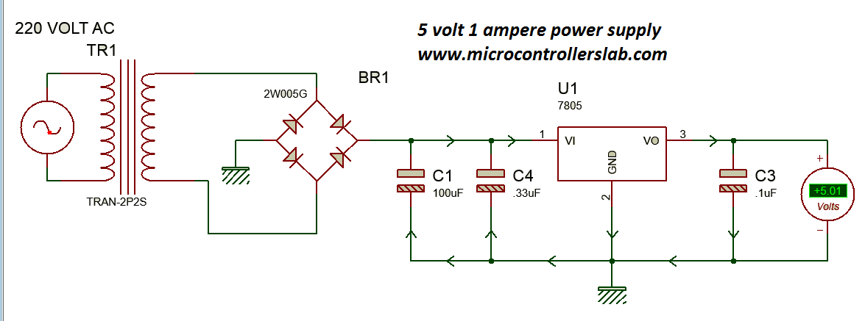
Full Bridge
上次完成
https://microcontrollerslab.com/power-supply-electronics-projects/
http://robustdesignconcepts.com/files/pspice/pmindex.htm
http://penzar.com/topspice/library.txt

Slide 5
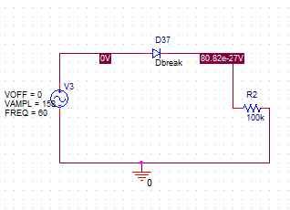
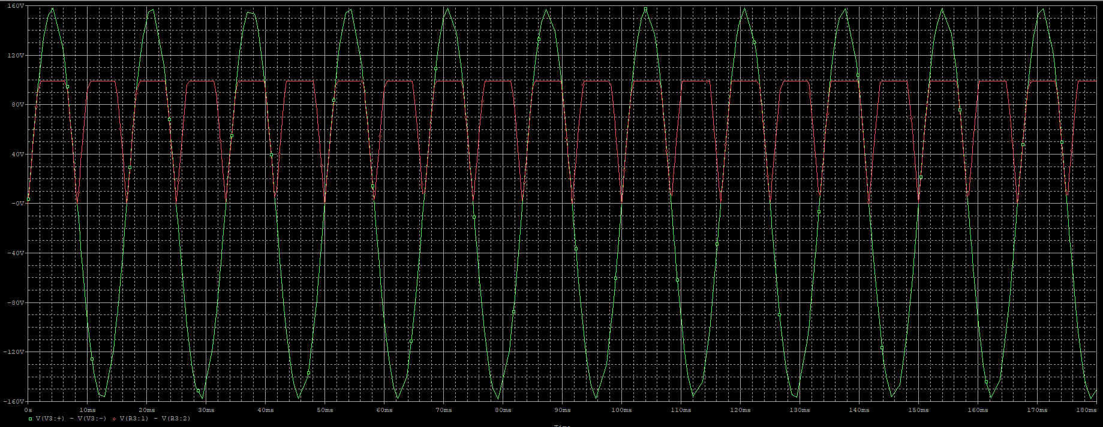
Simulation for Half Bridge Regulator - 1

Slide 6
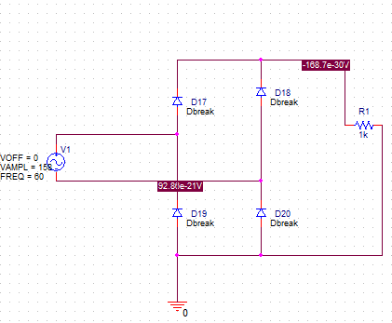
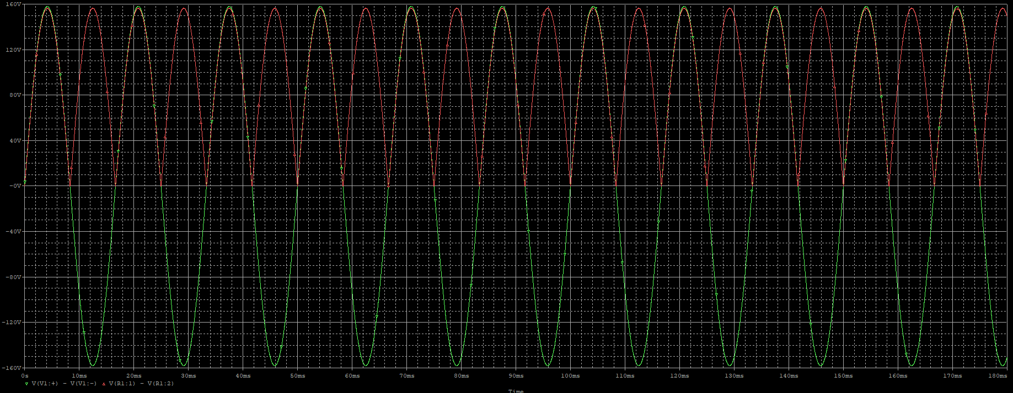
Simulation for Full Bridge Regulator - 1
練習(1)

Slide 7
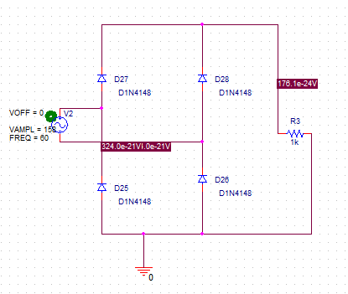
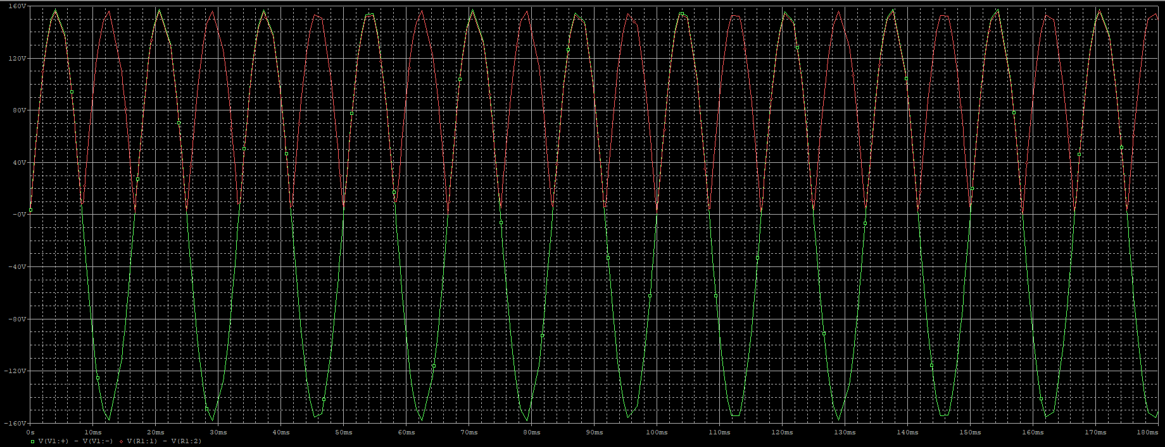
Simulation for Full Bridge Regulator - 2
練習(2)
Non-Ideal

Slide 8
至此，請作一個
Full Bridge
連接上星期之
“降壓 Transformer”
Vp = 110 rms
Vs = 12 rms

Slide 9
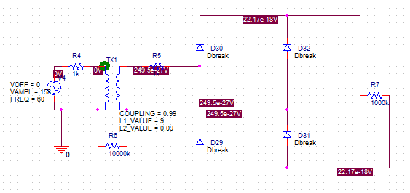
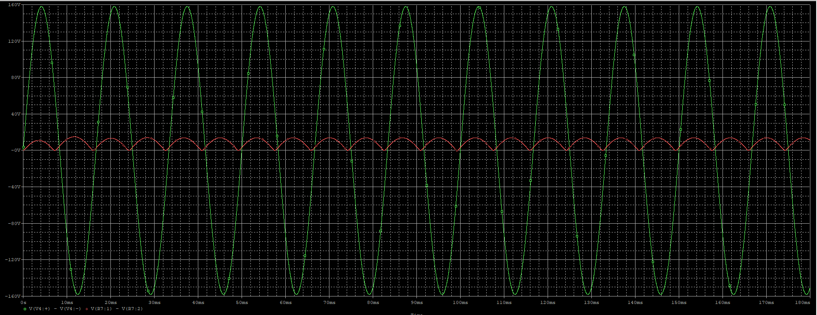

Slide 10
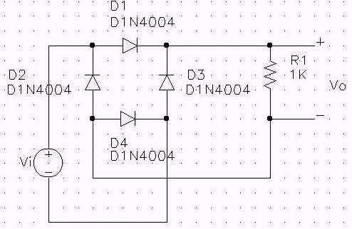
另一種繪圖方式

Slide 11
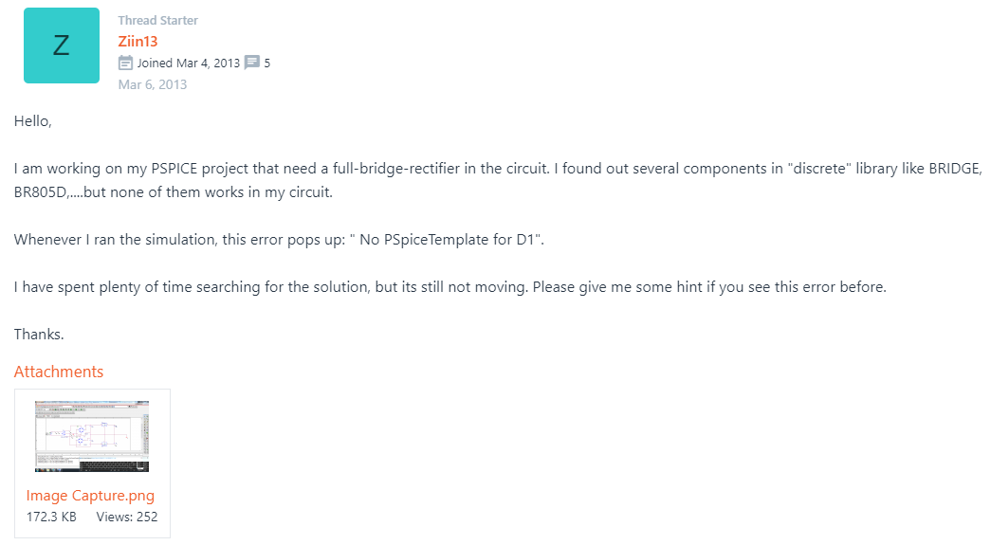
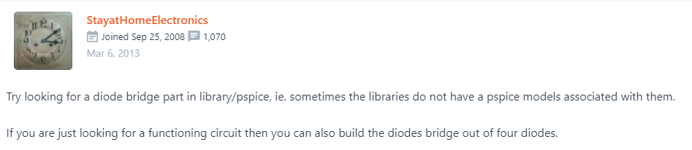
https://forum.allaboutcircuits.com/threads/pspice-full-bridge-rectifier-model.81963/

Slide 12
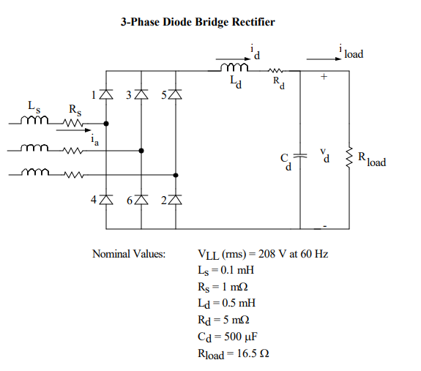
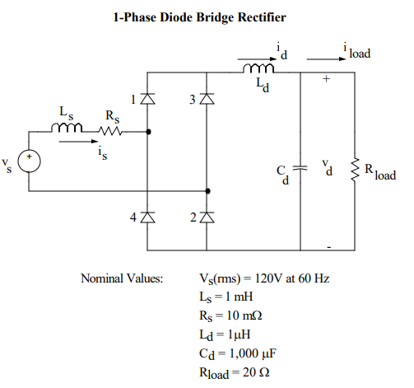
第十二週的電路學

Slide 13

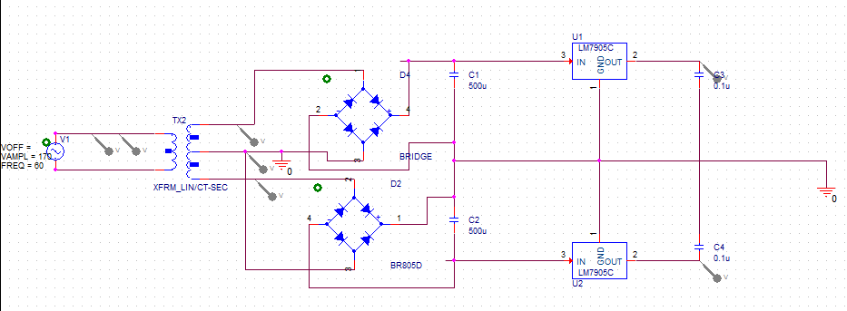
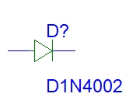
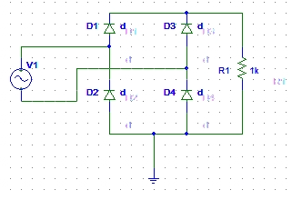
http://education.ema-eda.com/iTrain/PSpice163/PSpice_lesson9.html
https://www.pspice.com/passive/transformer
專用模組

